Slide 1
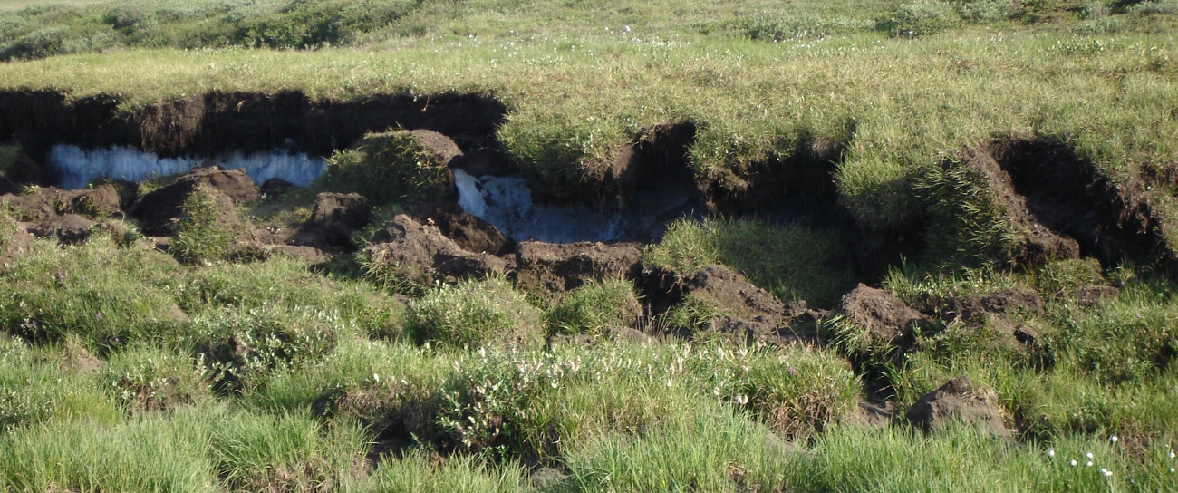
Soil Carbon Response to Environmental Change:
Initial Results from the Argonne TES SFA
J.D. Jastrow (representing the Argonne SFA team)
Conduct fundamental research to quantify and characterize the C stored in soils and evaluate its potential responses to environmental change
DOE/BER 26 June 2014

Slide 2
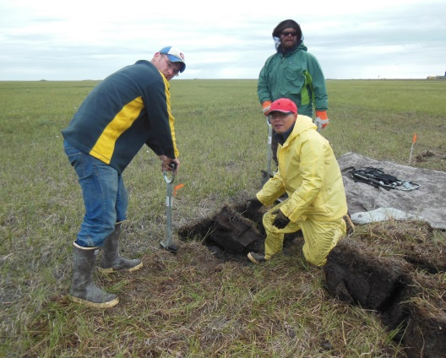
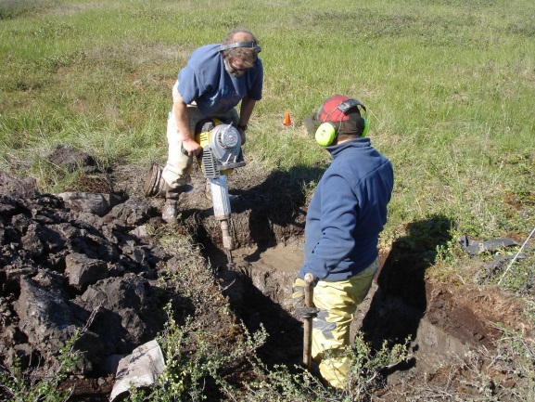
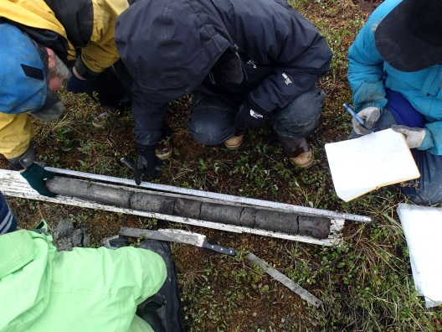
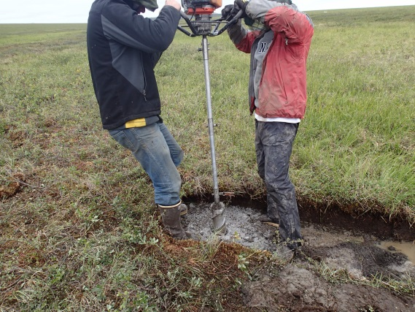
Argonne TES Scientific Focus Area
Conduct fundamental research to quantify and characterize the C stored in soils and evaluate its potential responses to environmental change
Our job:
Characterize the state of soil C stocks and their potential for change
This requires that we consider/understand
  stabilization mechanisms
  soil forming processes
  potential vulnerabilities
Incorporate understanding of mechanisms and processes into our research strategies
Provide results to support model development and improve model performance
Focus on regions
  critically sensitive to environmental forcing
  where modeling uncertainties are high
Address region-specific factors/processes controlling
  soil C distributions,
  potential response to forcing, and
  knowledge gaps

Slide 3
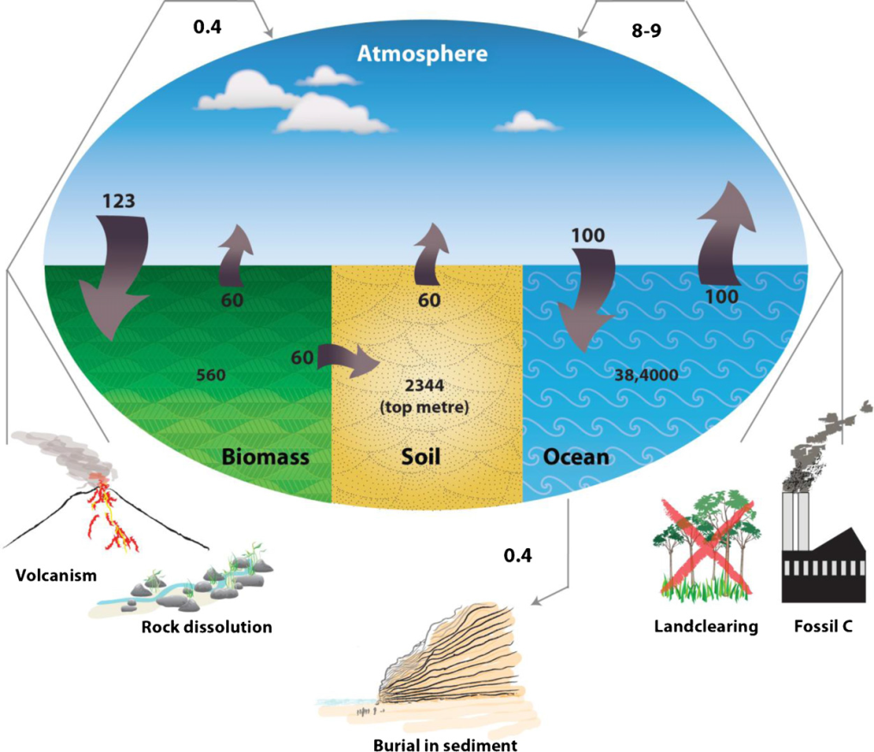
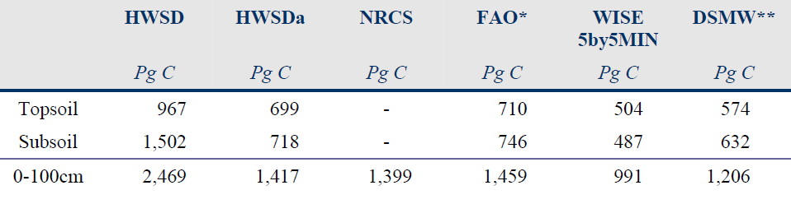
Soils hold largest terrestrial reservoir of carbon
Large range in estimates
Ongoing efforts to improve estimates (needed for ESMs)
Aided by new observations and advancements in extrapolation methods
Stockmann et al., 2013.
Agric. Ecosys. Environ.
164:80-99.
Hiederer & Köchy, 2011. Global Soil Organic Carbon
Estimates and the Harmonized World Soil Database. EUR25225.

Slide 4
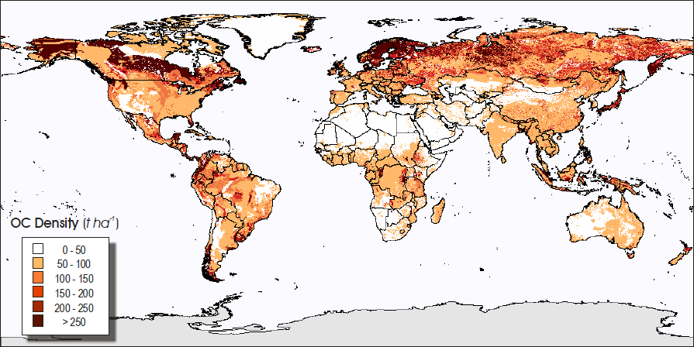
Recent work substantially increased estimates of permafrost region soil C stocks
Permafrost region covers 16% of global land area
Current estimates relative to global soil C
  >25% at 1 meter
  One third at 3 meters
Hiederer & Köchy, 2011. Global Soil Organic Carbon Estimates and the Harmonized World Soil Database. EUR25225.
 | Pg C (Jobbagy & Jackson, 2000) |  |  | Pg C (Tarnocai et al., 2009)
Depth | Global | Boreal & Tundra (20 x 10⁶ km²) | % of Global | Permafrost Region (18.8 x 10⁶ km²) | Revised Global | % of Revised Global
0-1 m | 1502 | 226 | 15 | 496 | 1772 | 28
1-3 m | 842 | 69 | 8 | 528 | 1301 | 41
0-3 m | 2344 | 295 | 13 | 1024 | 3073 | 33
Jobbagy & Jackson, 2000, Ecol. Appl. 10:423-436. Tarnocai et al., 2009, Global Biogeochem. Cycles 23:GB2023.

Slide 5
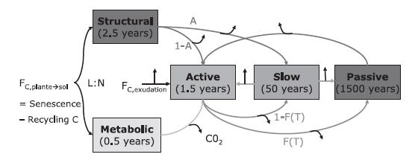

Permafrost-region SOC stocks exist in a state of disequilibrium — this creates a problem for models
General assumption of steady-state between plant inputs and SOM mineralization for initialization
Models are “spun up” to “equilibrium” SOC by simulating plant inputs and mineralization from conceptual SOM pools (with different turnover times) as modified by MAT, MAP, and soil texture
This works well for most soils, but not in the permafrost region
Plant inputs

Slide 6
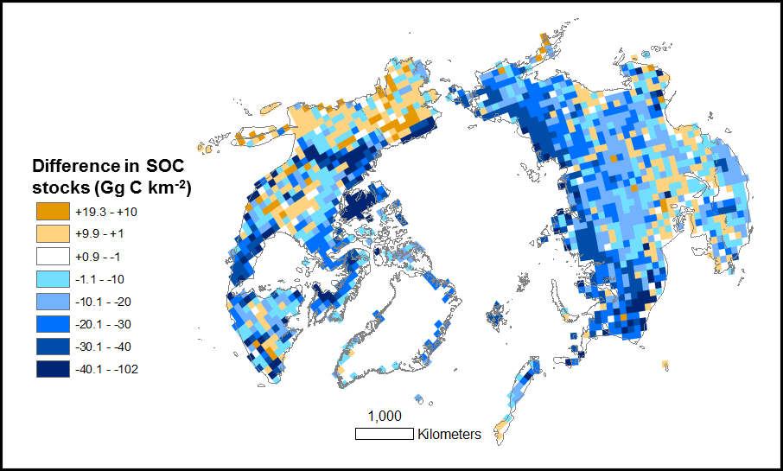
Discrepancy between modeled and observed C stocks — Soil C stocks are underestimated by models.
Blue colors show model under-predictions.
Model developers are working to simulate the unique processes occurring in permafrost region soils
But model validation is difficult because observational estimates are poorly constrained
Comparison between the Northern Circumpolar Soil Carbon Database (Hugelius et al., 2013. Earth Syst. Sci. Data Discuss. 6:73–93) and baseline Earth System Model estimates (BCC-CSM1.1, CanESM2, MIROC-ESM, GFDL-ESM2M).
Mishra et al., 2013. Environ. Res. Lett. 8:035020.

Slide 7
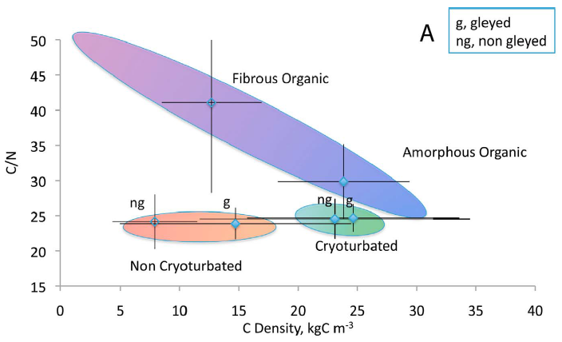
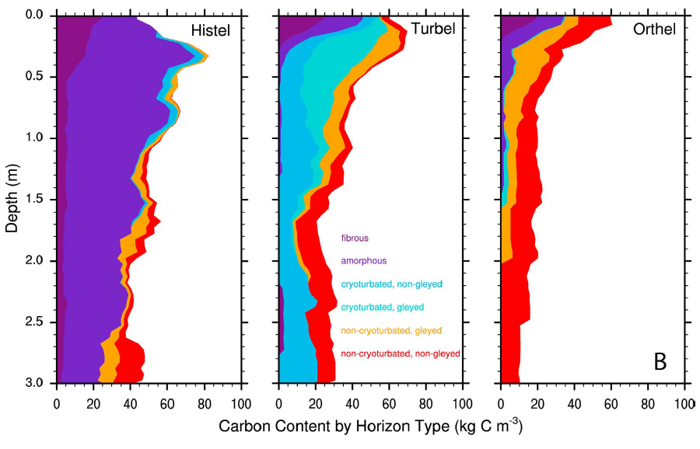
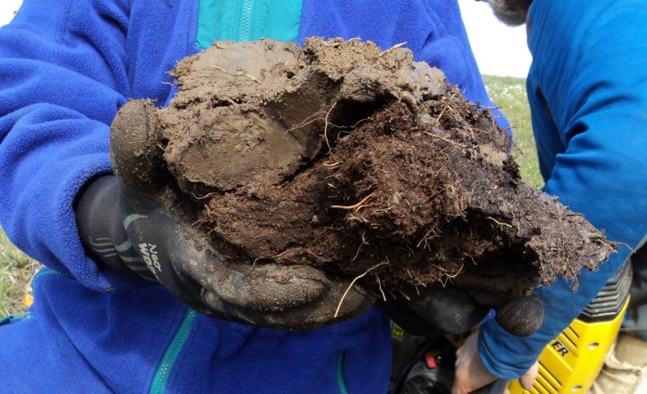
Even less is known about decomposability
Relatively labile or unstabilized, uncomplexed SOM protected by frozen and wet conditions
Unlike other regions, this type of SOM can exist throughout the soil profile due to cryoturbation,
peat formation, and burial
by sediment deposition
Non-
cryoturbated
Organic
Cryoturbated
Harden et al., 2012. GRL 39, L15704.

Slide 8
Argonne TES SFA Goal & Objectives
SFA Goal: Quantify C currently preserved in permafrost region soils, determine its spatial and vertical distributions, and assess its susceptibility to decomposition and release to the atmosphere
Obj. 1: Spatial and vertical distributions of soil C stocks
Obj. 2: Empirical tools for predicting potential decomposability
Obj. 1: Spatial and vertical distributions of soil C stocks

Slide 9
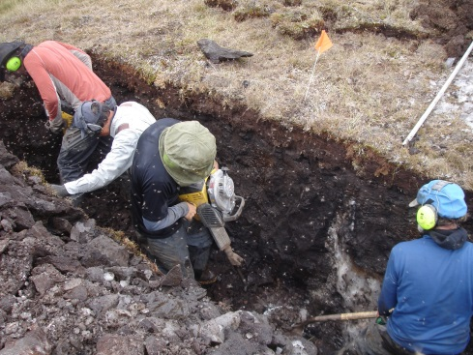
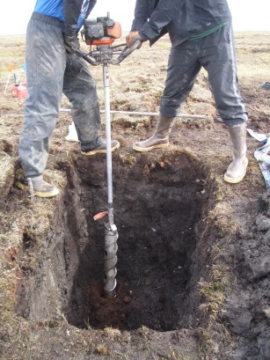
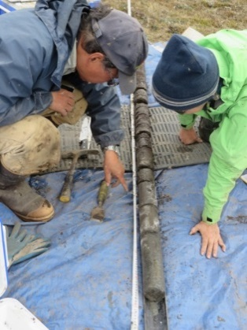
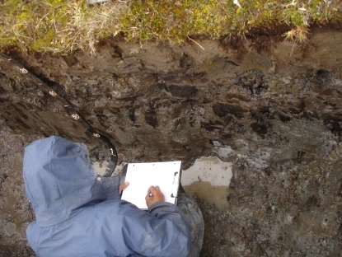
Argonne TES SFA Goal & Objectives
SFA Goal: Quantify C currently preserved in permafrost region soils, determine its spatial and vertical distributions, and assess its susceptibility to decomposition and release to the atmosphere
Obj. 1: Spatial and vertical distributions of soil C stocks
Obj. 2: Empirical tools for predicting potential decomposability
Obj. 1: Spatial and vertical distributions of soil C stocks
Aim to produce high-resolution maps of the spatial and vertical distributions of soil C stocks
Target new sample/data collection on under-sampled areas of high heterogeneity/uncertainty

Slide 10
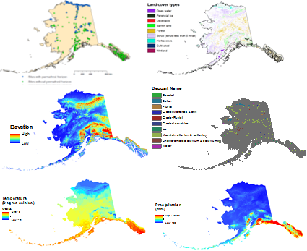
Argonne TES SFA Goal & Objectives
SFA Goal: Quantify C currently preserved in permafrost region soils, determine its spatial and vertical distributions, and assess its susceptibility to decomposition and release to the atmosphere
Obj. 1: Spatial and vertical distributions of soil C stocks
Obj. 2: Empirical tools for predicting potential decomposability
Obj. 1: Spatial and vertical distributions of soil C stocks
Aim to produce high-resolution maps of the spatial and vertical distributions of soil C stocks
Target new sample/data collection on under-sampled areas of high heterogeneity/uncertainty
Maps generated by pedometric understanding of soil forming factors and robust geospatial modeling techniques

Slide 11
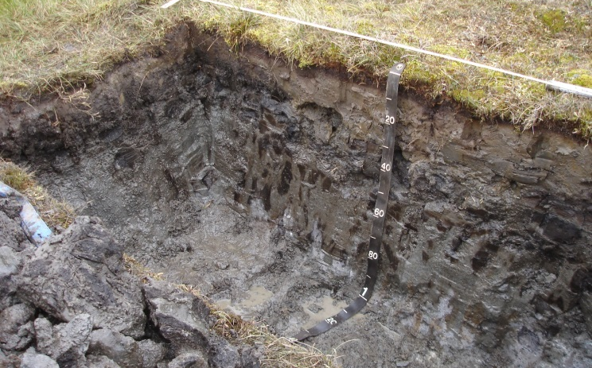
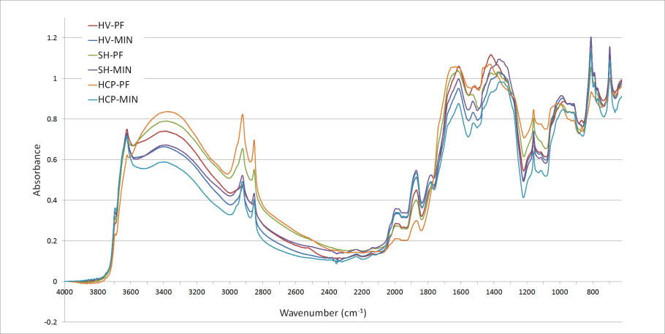
Argonne TES SFA Goal & Objectives
SFA Goal: Quantify C currently preserved in permafrost region soils, determine its spatial and vertical distributions, and assess its susceptibility to decomposition and release to the atmosphere
Obj. 1: Spatial and vertical distributions of soil C stocks
Obj. 2: Empirical tools for predicting potential decomposability
Aim to produce measures of intrinsic soil C decomposability to address calibration and validation needs of large-scale models
Initial focus on assessing relative degradation levels of existing SOM, both vertically and spatially
MidIR spectroscopy
Notes:
This version of slide shows cryoturbated organic and mineral horizons (as well as surface OM) in a soil pit (instead of previous picture which was a closeup of cryoturbated soil) to better represent the vertical and spatial distributions part of second bullet

Slide 12
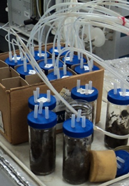
Argonne TES SFA Goal & Objectives
SFA Goal: Quantify C currently preserved in permafrost region soils, determine its spatial and vertical distributions, and assess its susceptibility to decomposition and release to the atmosphere
Obj. 1: Spatial and vertical distributions of soil C stocks
Obj. 2: Empirical tools for predicting potential decomposability
Aim to produce measures of intrinsic soil C decomposability to address calibration and validation needs of large-scale models
Initial focus on assessing relative degradation levels of existing SOM, both vertically and spatially
  Longer-term goals are apportionment of existing SOC stocks into model pools and evaluation of their intrinsic turnover times (decay rates)
MidIR spectroscopy
Notes:
This version of slide shows cryoturbated organic and mineral horizons (as well as surface OM) in a soil pit (instead of previous picture which was a closeup of cryoturbated soil) to better represent the vertical and spatial distributions part of second bullet

Slide 13
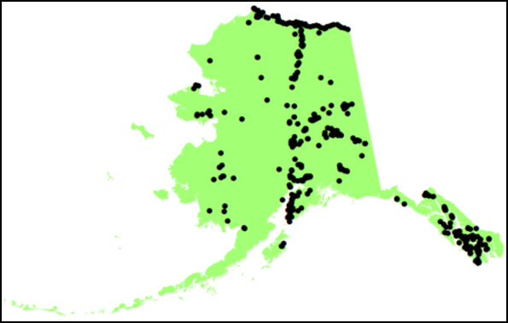
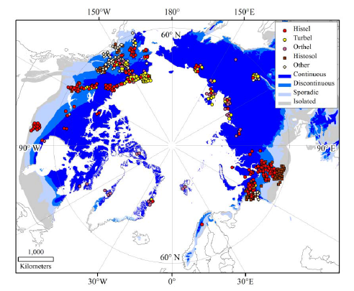
Databases for soil C stocks are growing but still unevenly distributed and low density
Depth interval (cm) | Alaska | Circumpolar
0-100 | 184 | 1778
100-200 | 238 | 168
200-300 | 50 | 356
Total | 472 | 2302
Alaska data density
= 1 sample/ 2500 km²
(Mishra & Riley, 2012)
Circumpolar data density
= 1 sample/8100 km²
(Hugelius et al., 2013)

Slide 14
How can we advance knowledge and reduce uncertainties (without a fleet of helicopters)?
Sampling efforts and new data generation
  Target under-sampled areas of high heterogeneity/uncertainty
  Leverage opportunities – low hanging fruit
  Identify and prioritize sampling locations – based on geospatial analysis of existing uncertainties
Improve on geospatial extrapolations
  Apply state-of-the-art geospatial modeling and digital soil mapping methods
  Provide uncertainty assessments

Slide 15
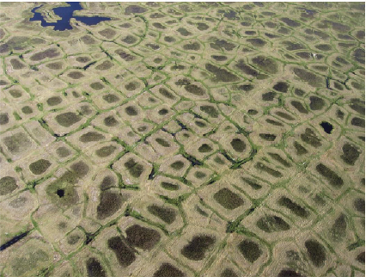
New assessments of soil C distributions
Initial sampling/data collection efforts focused on
ice-wedge polygons; decision was based on:
Spatial extent (>6.4 million km² across the Pan-Arctic)
Literature and expert knowledge
  Cryoturbated soils – high spatial heterogeneity
  High C stocks
Potential for improved
up-scaling/geospatial modeling
  Large-scale patterns (~5-20 m)
  Aerial imagery/remote sensing tools
  High resolution lidar availability
Later sampling/data collection efforts
guided by geospatial analyses of uncertainty
Photo: C-L Ping.

Slide 16
Combining environmental correlations and spatial autocorrelation (regression kriging)
Geospatial modeling: Including soil forming factors to reduce variability and produce high resolution maps
Topographic attributes
Climatic parameters
Land cover
types
Surficial
geology
SOC
observations
Geographically weighted regression
Predicted
SOC
Spatial
interpolation
SOC variability across study area predicted using observations and soil forming factors
Residuals derived at model calibration sites and tested for spatial correlation
If autocorrelated, residuals map created using spatial interpolation
Final predicted SOC map created by adding regression predictions and residuals map
Created SOC maps validated and uncertainty analysis done
Residuals at observations
Regression
kriging
Validation & uncertainty analysis

Slide 17
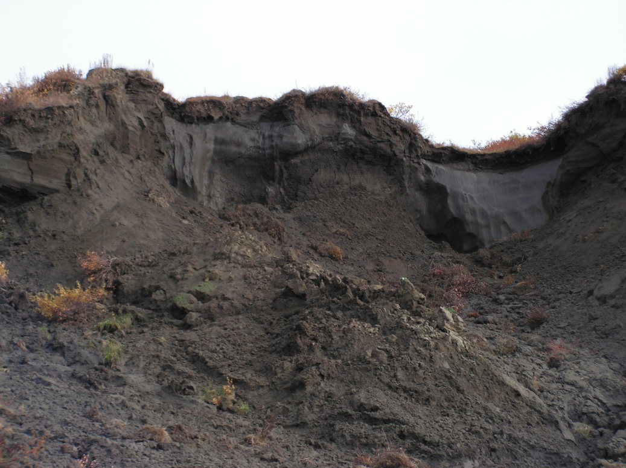
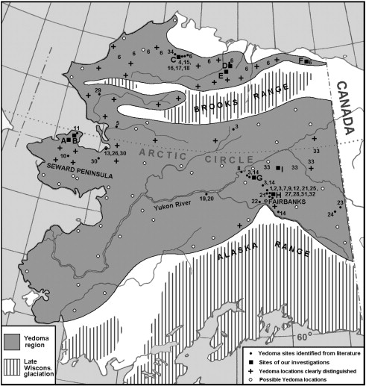
New measurements of deep carbon deposits
From Tarnocai et al., (2009)
Picture: K.W. Anthony
Courtesy of A. Kholodov
Yedoma is a key knowledge gap for estimating SOC stocks in the Arctic:
  May account for as much as 24% of the total SOC in circumpolar region
  High uncertainty in yedoma SOC stocks
  Large area in Alaska, but extremely small number of depth profiles with C data
Kanevskiy et al. (2011)

Slide 18
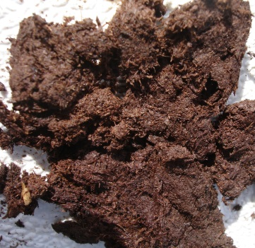
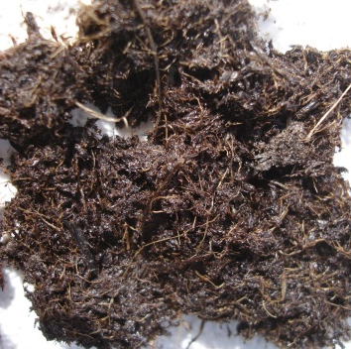
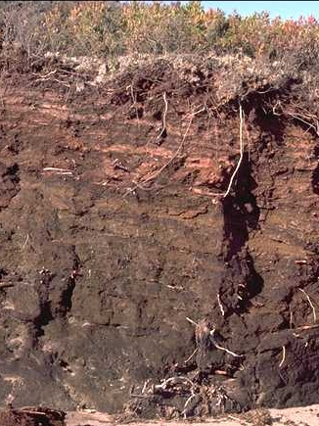
With warming — Large amounts of undecomposed or uncomplexed SOM will become more vulnerable to mineralization
Soils are old – but only weakly developed (“frozen” in time)
Mineral associations and physical protection mechanisms are less important
Composition of soil C forms is a more dominant determinant of intrinsic decomposability

Slide 19
Key criteria for broad-scale evaluation and prediction of relative degradation state of existing SOM
Ability to measure many samples (new and archived)
Small sample size (especially for archived samples)
Minimal sample prep
Rapid, efficient, low cost, reproducible
Information rich
Data output amenable to building accessible databases
Diffuse reflectance Fourier-transform
mid-infrared spectroscopy (MidIR)

Slide 20
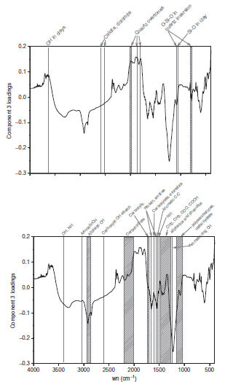
Relevant MidIR analytical/interpretation approaches
Characterize soil C forms
Important C functional groups (e.g., carbohydrates, proteins, labile fatty acids)
Refractory or insoluble forms (black C, “humified” materials)
Band ratios to indicate level of degradation
Information on soil minerals
Clays, carbonates, silicates
Indicator of potential for organomineral stabilization
Calderon et al., 2011. Comm. Soil Sci. Plant Anal. 42:21434-2159.

Slide 21
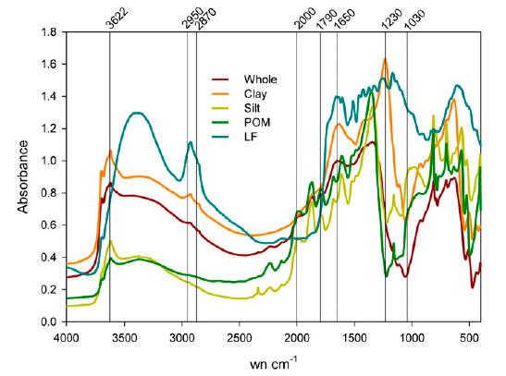
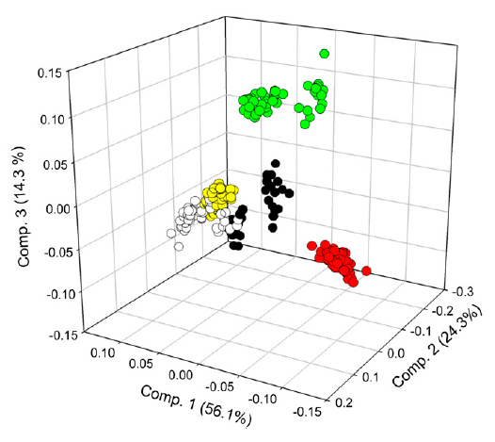
Relevant MidIR analytical/interpretation approaches
Chemometric analysis
Calibrations to predict “conventionally” isolated SOM fractions (time-saving and useful
for limited sample sizes)
Multivariate analyses in other systems have related MidIR to:
Landscape gradients of land use
Litter decomposition rates
Mineralization rates in incubation studies
Calderon et al., 2011.
Soil Sci. Soc. Am. J. 75:568-579.

Slide 22
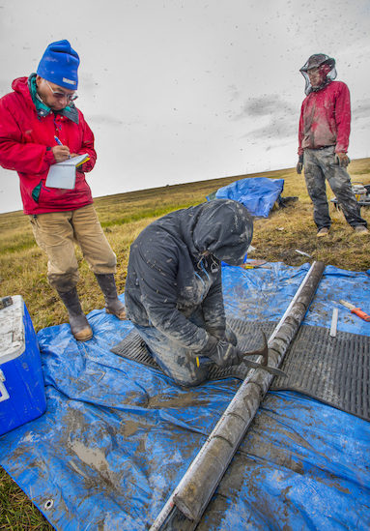
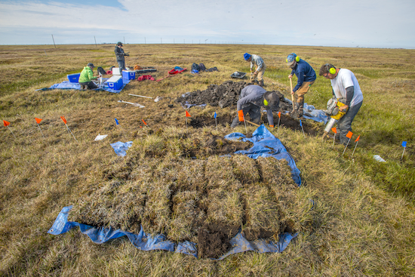
Getting dirty muddy — Initial activities/progress
Spatial distribution of soil carbon stocks in polygonal ground
Deep carbon stocks in Yedoma
Mid-infrared spectroscopy
©University of California,
Lawrence Berkeley National Laboratory
©University of California,
Lawrence Berkeley National Laboratory

Slide 23
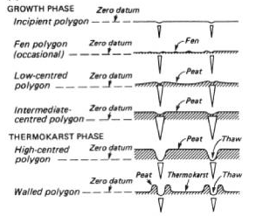
Life cycle of ice-wedge polygons
Flat-centered
Low-centered
Raised flat
High-centered
French, H.M. 2007. The Periglacial Environment, 3rd Ed. John Wiley & Sons.

Slide 24
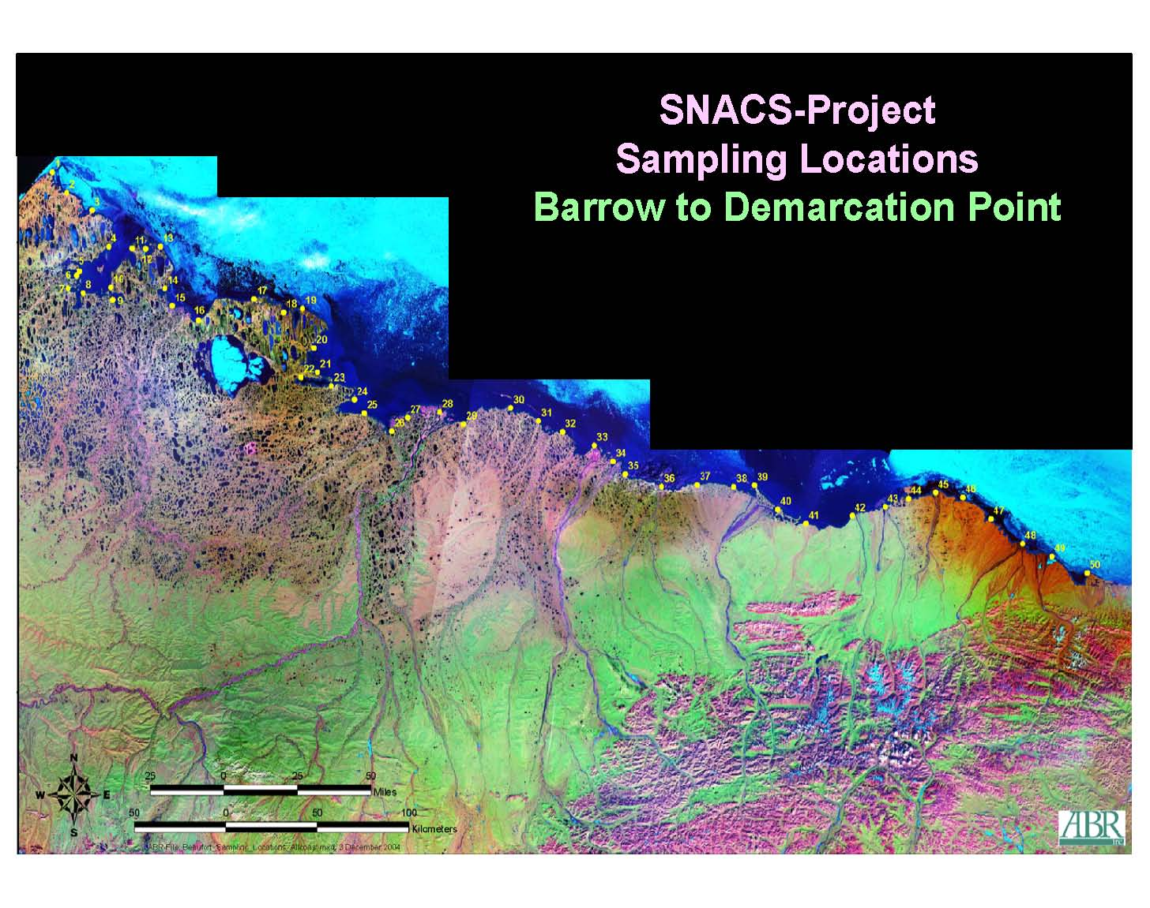
Barrow
(3x FCP, LCP, HCP; 2013)
Polygonal Ground Study Sites
North Slope, Alaska
Prudhoe Bay
(2x FCP, LCP, HCP; 2012, 2014)
Arctic Foothills
(3x HCP; 2014)
Kaktovik
(3x FCP, HCP; 2015)
Alaska

Slide 25
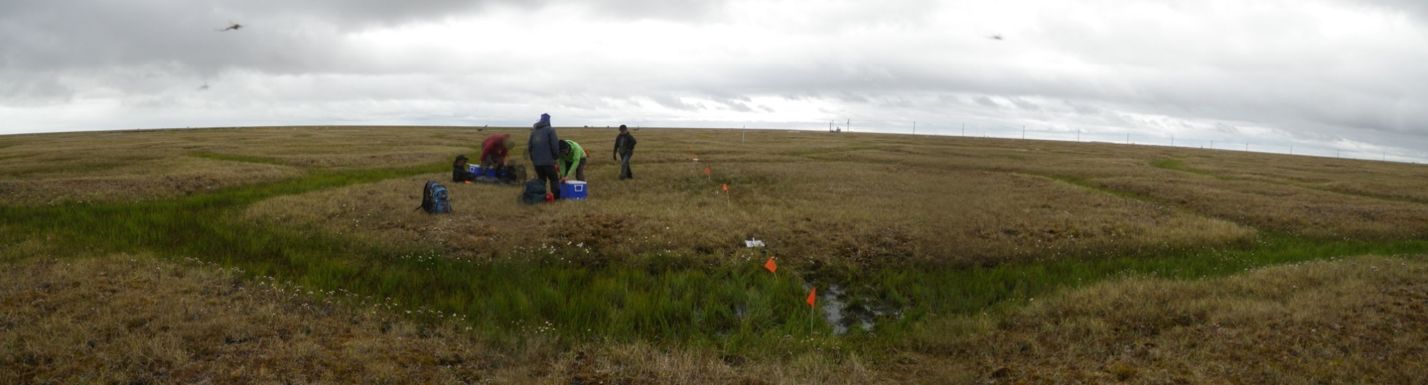


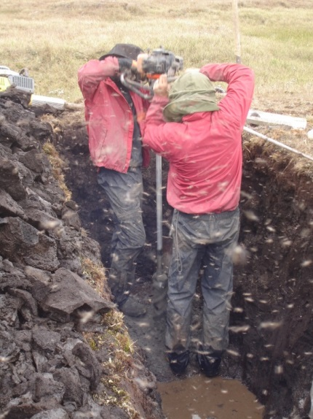
Sampling
Excavated trench (open pit) to ~1.5-m depth from center of the ice wedge trough toward polygon center
Used gas-powered Sipre auger to core below pit bottom to depths of 2-3 m

Slide 26
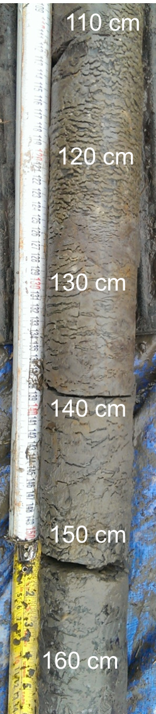
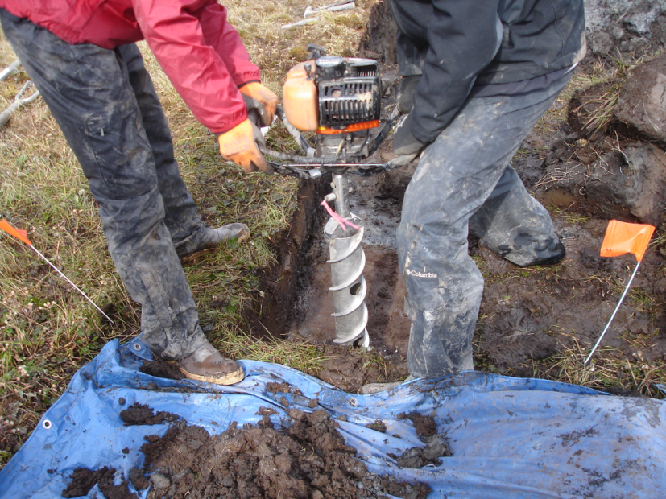

Sampling
Auger along remainder of the center line coring at
50-250 cm intervals (depending on polygon size)
Describe cryogenic features and soil horizons of soil pit and cores according to French and Shur (2010) and Ping et al. (2013)

Slide 27
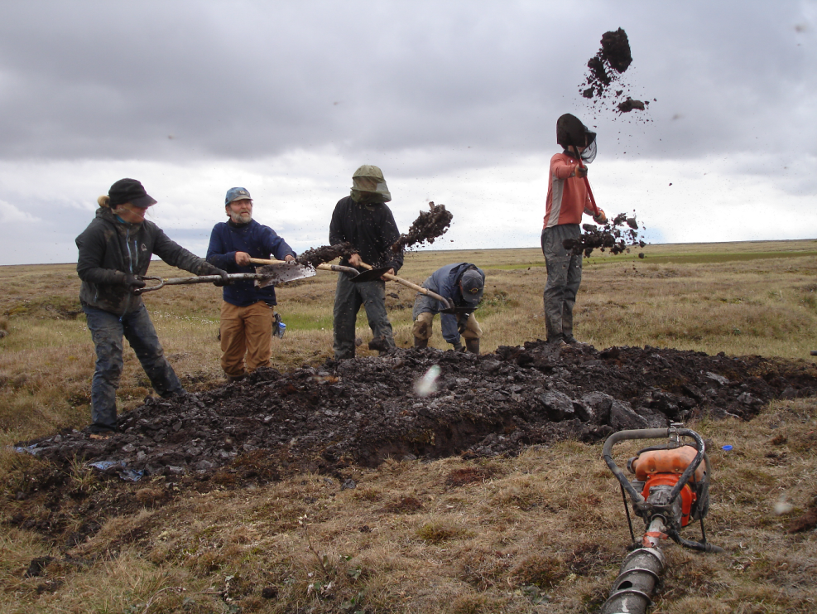
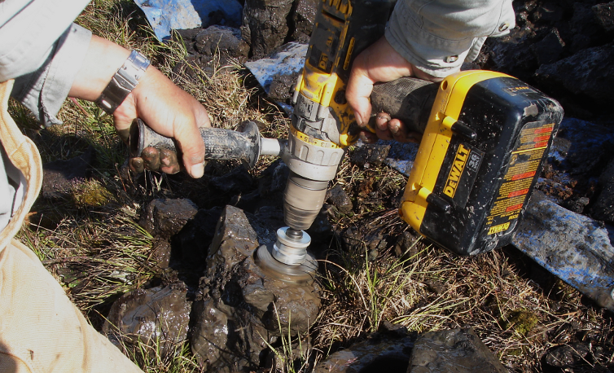
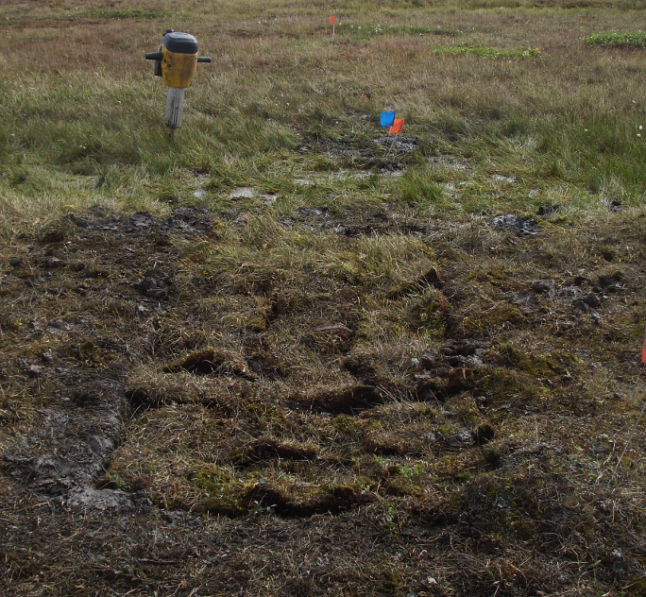
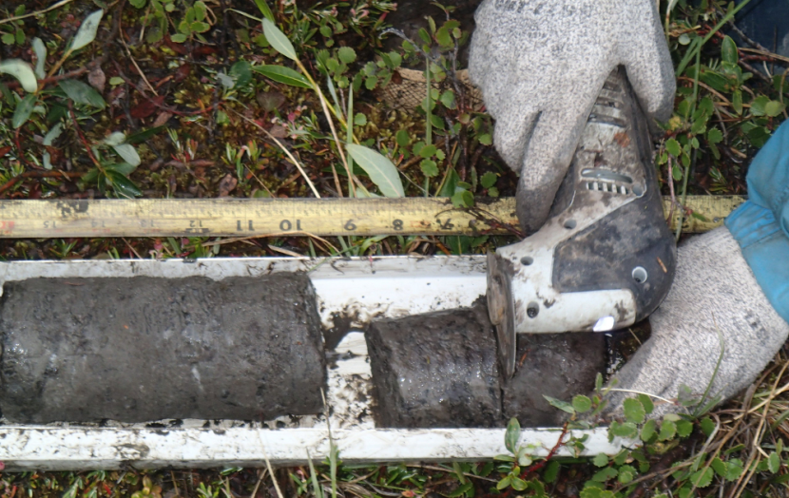
Sampling
Bulk density sampled by coring with hand drill or from Sipre cores
Site recovery

Slide 28
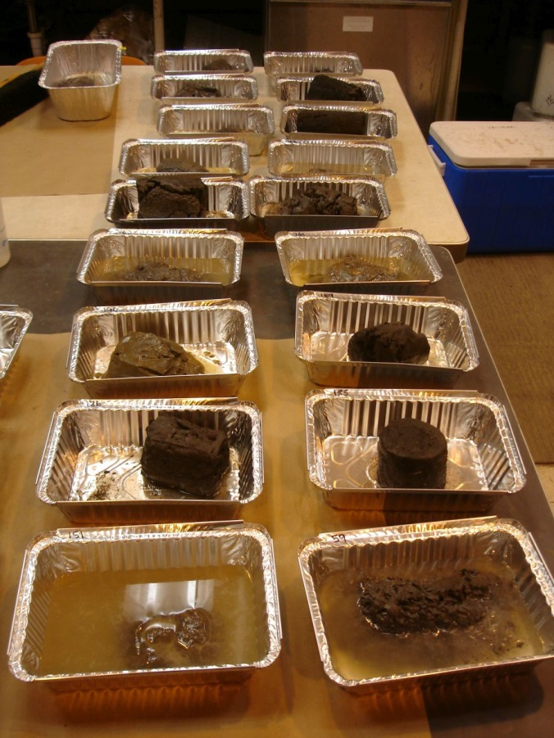
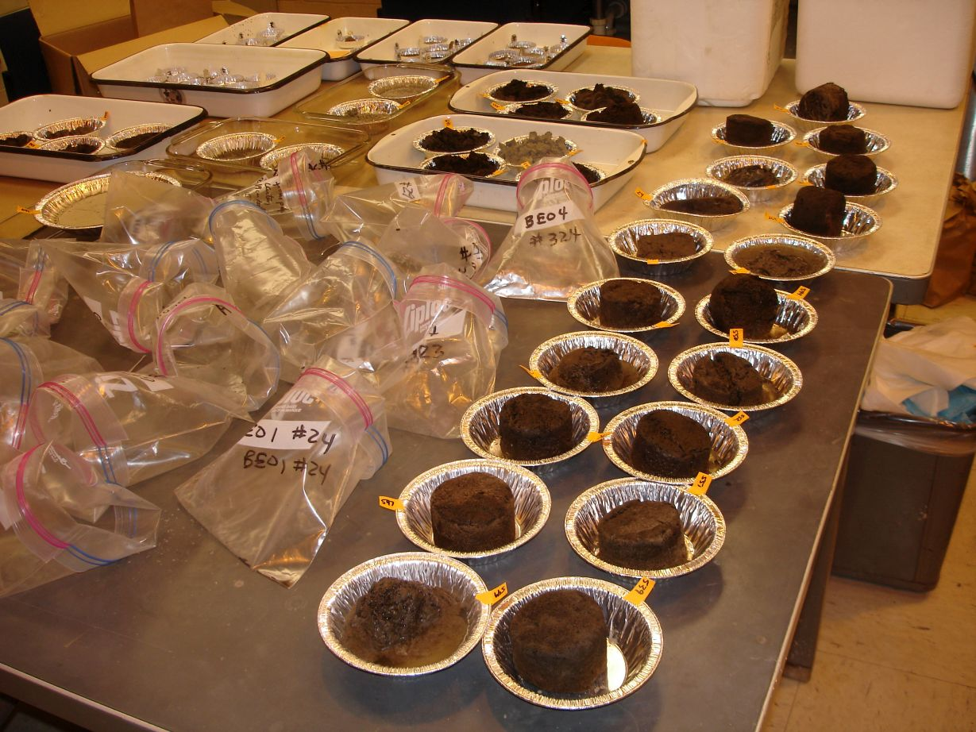
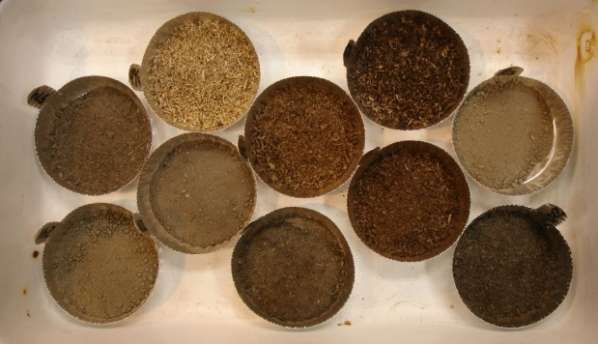
Sample processing and analysis
From Barrow, 664 soil samples shipped frozen to Argonne for drying, sieving, grinding and other prep work
Determination of water (ice) content, TOC, TC & TN, plus other analyses

Slide 29
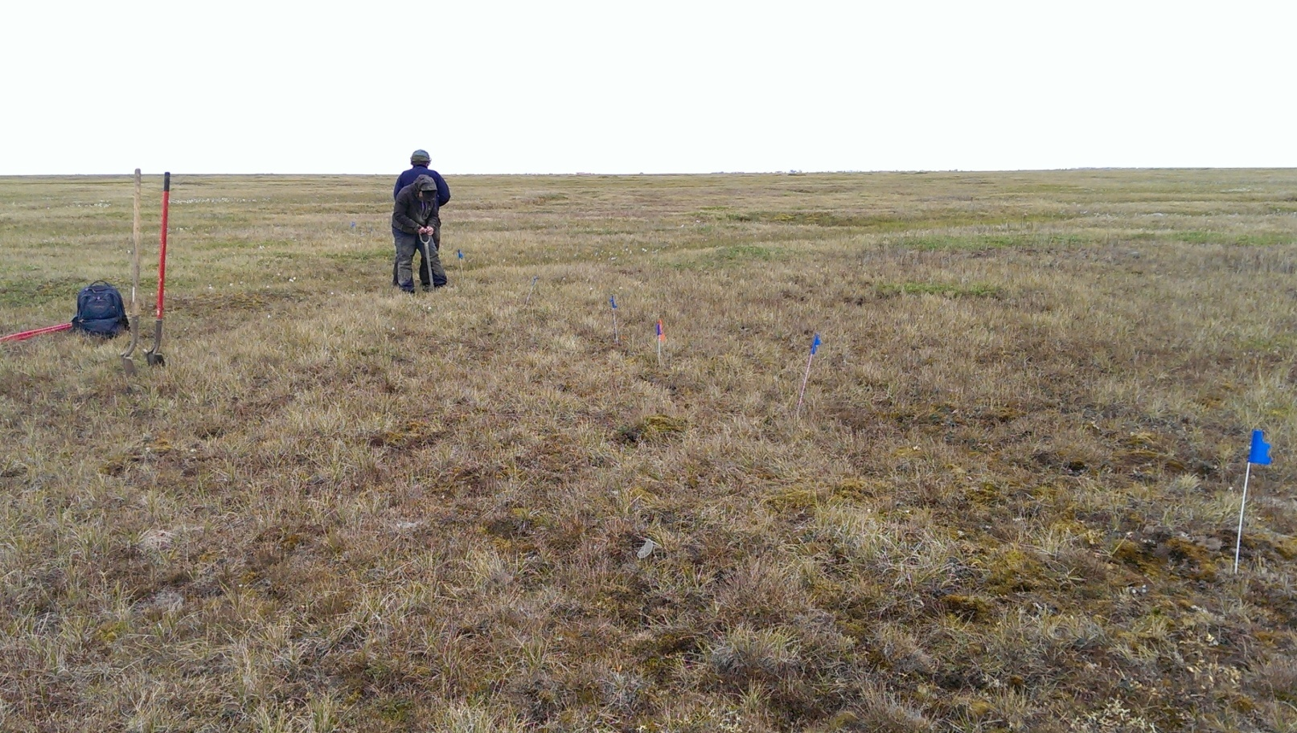
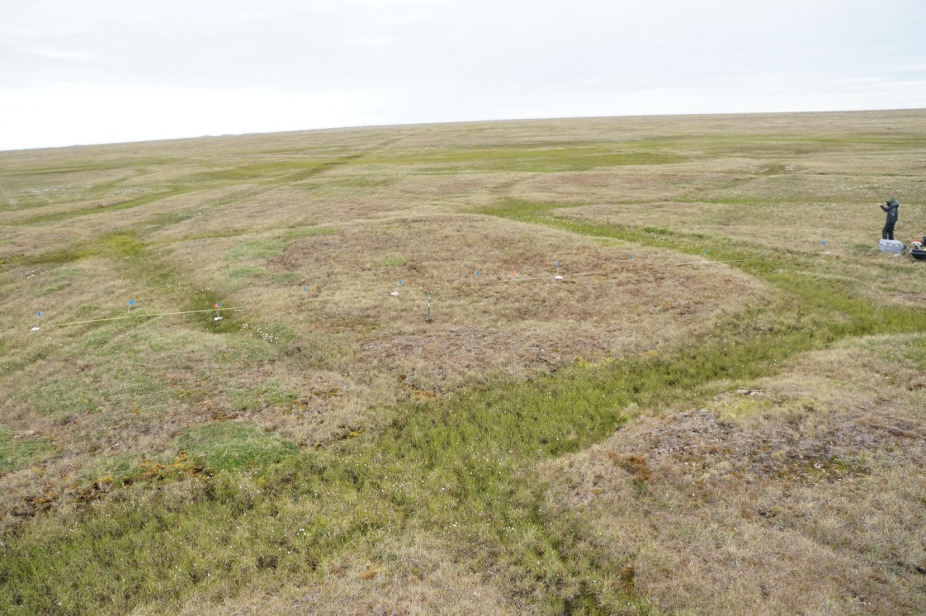
Flat-centered ice wedge polygons — the landscape
Courtesy of B. Dafflon, LBNL

Slide 30
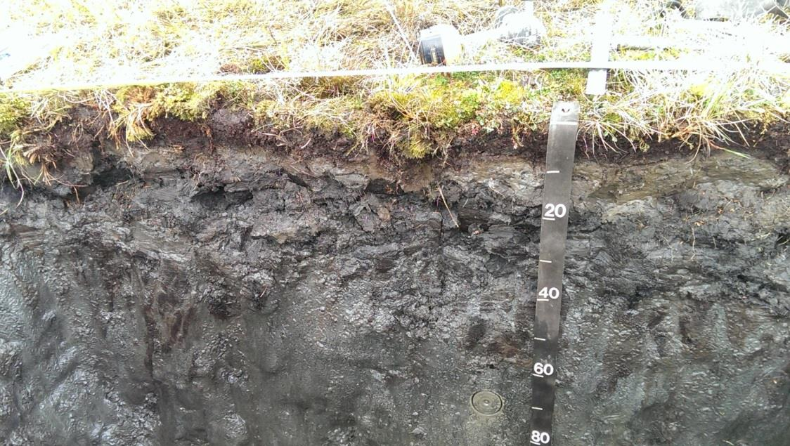


Record and describe the soil profile and cryostratigraphy of soil pits and cores
Flat-centered polygon

Slide 31


Determination of soil C stocks:
Dealing with cryoturbation

Slide 32

Soil profile of a flat-centered polygon from center of ice wedge to polygon center
Normalized horizon thickness calculated for each horizontal meter based on scale drawings

Slide 33
Spatially and vertically resolved estimation of soil organic C stocks
Contour plot showing density distribution of C stocks by normalized horizon thickness for generalized horizon types across ½ polygon. White area is ice wedge
Vertical distribution of SOC stocks summed for each horizontal meter across polygon

Slide 34


Landscape of low-centered polygons
Courtesy of B. Dafflon, LBNL

Slide 35

Soil profile and cryostratigraphy of a low-centered ice wedge polygon

Slide 36


Landscape of high-centered polygons
Courtesy of B. Dafflon, LBNL

Slide 37


Soil profile and cryostratigraphy of a high-centered ice wedge polygon

Slide 38
Spatial heterogeneity and density of C stocks varies for different polygon types
Flat-centered polygon
Low-centered polygon
High-centered polygon

Slide 39
Soil organic C stocks and ice content to 2-m depth
Ice wedge = 1.9 m
Variations in:
Soil C stocks and ice content
Ice wedge dimensions
Quality and thickness of surface organic horizons
Flat-centered polygon (BEO6)
Ice wedge = 2.3 m
Ice wedge = 3.5 m
Low centered polygon (BEO5)
High centered polygon (BEO1)

Slide 40

Collaborative links to NGEE Arctic
Electrical resistivity tomography (ERT)
“Simple” ERT interpretation
Red = high ice content (80% ice in ataxitic structure or ice-wedge)
Yellow = frozen but less ice
Blue = unfrozen water at surface or soft-frozen saline layer at depth

Slide 41

Implications for up-scaling
Potential for up-scaling based on:
polygon-scale variation
(i.e., trough vs. center)
landscape-scale variation
(i.e., by polygon type)
Lidar DEM
(Source: NGEE Arctic)

Slide 42

Implications for sampling
vs.
Even if total C stocks appear uniform across center
“Blind” coring without sufficient replication could lead to gross over- or under-estimation
Results will address:
How many samples are needed?
What are the uncertainties?

Slide 43








Yedoma sampling, March 2014
Yedoma Campaign, March 14-21, 2014, ANL, UAF collaborators, A. Khodolov and V. Romanovsky, and UF collaborators T. Schuur, and J. Hutchings
Two cores: Core 1: Fairbanks area = 9 m depth, and Core 2: mile 11 Dalton Hwy = 11 m depth. Total of 150 samples.
  Silt with organic inclusions and lenticular, microlenticular and porous ice cryostructures
  Ice wedge with silt and organic intrusions
On-going analysis:
  Interpretation of yedoma cryostratigraphy, bulk density, ice content, texture, thermal conductivity, elemental C & N, 13C, MidIR, biomarkers, PLFA’s, DNA
Itkillik yedoma exposure in Kanevskiy et al., (2011)
Sediments
Ice wedge
Ice wedge

Slide 44
Building the MidIR database & exploring interpretations
Samples in hand (besides our own samples)
  Latitudinal gradient across Alaska (Ping & Michaelson: 119 samples)
  Siberia, Greenland, Canada (Hugelius, Kuhry, & Palmtag: 400 samples)
Samples promised or “under discussion”
  Siberia incubations (Richter: ~100)
  Alaska long-term incubations (Schuur: ~100)
  Alaska and possibly other locations (NRCS: potentially hundreds)
  Alaska, Canada, Svalbard, Russia, and Norway (KOPRI)
  More casual discussions with others
Exploring interpretations
  Landscape
  Incubations
  Conventional indicators (fractions)

Slide 45

Initial MidIR analyses of latitudinal gradient of Alaskan soils including multiple depths
119 samples;
SOC range = 0.2–50%

Slide 46

Ratios of characteristic bands — a simple means for comparing spectra & evaluating soil quality differences
Spectra sample key
Black spruce, organic soil (44% C, 0-14 cm)
Moist non-acidic tundra, cryoturbated organic soil (15% C, permafrost, 60-80 cm)
Moist non-acidic tundra, cryoturbated mineral soil
(5% C, permafrost, 60-80 cm)
CI and the HU indices expected to be higher when SOM is more degraded

Slide 47

Principal components analysis of five band ratios for the latitudinal gradient
Soils associated with different land covers are scattered in coordinate space
Suggests band ratios might serve as robust indicators across different ecosystems & plant litter sources

Slide 48
Principal components analysis of five band ratios for the latitudinal gradient
PC Axis 1 correlates strongly with the general O-M band ratio, soil organic C, total N, & cation exchange capacity
Soils with negative PC axis 1 values have <15% SOC and often have a higher CI (indicating a “more decomposed” state)
<15% SOC
>15% SOC

Slide 49
Principal components analysis of five band ratios for the latitudinal gradient
Strongest correlations with PC Axis 2 were for HU1 (negative) and CI (positive)
Suggests this axis is related to differences in soil C chemistry (polysaccharides, aromatic, aliphatic)
Do CI and HU1 target/separate different organic matter qualities?
% clay, pH, base saturation
Notes:
PCA Axis 2 might be negatively correlated with aliphatics -- higher aliphatics and lower polysaccharides below zero while lower aliphatics and higher aromatics above zero

Slide 50



Leveraging LDRD investments
60-day incubations
Environmental drivers
  Temperature: -1, 1, 4, 8, 16°C
  Drainage (drained vs. flooded)

Slide 51



LDRD incubation studies
Samples from 4 sites representing major Arctic vegetation/soil types
  Active layer organic horizon
  Active layer mineral horizon
  Upper permafrost (cryoturbated
  organic/mineral soil)

Slide 52
CI and HU1 band ratios can vary significantly among sites and horizons within sites
Higher values for both CI and HU1 are interpreted in the literature as indicating a “more decomposed” state
CI seems to follow this pattern for horizons within sites, but HU1 does not fit
Influences of DOC, plant, and microbial C sources???

Slide 53
Exploration of relationships with cumulative respired CO₂ in 60-day incubation studies at 4°C
HU1 might be a good indicator of lability for comparing active layer organic soils, even at low temperatures
None of selected band ratios were strongly indicative of respired CO₂ at 4°C from AL mineral or permafrost soils
Suggests these band ratios may not be indicative of substrates being mineralized at low temperatures in these layers
“More decomposed”

Slide 54




Comparisons to “conventional” measurements: Physically separated soil organic matter fractions

Slide 55
Size fractions have spectral differences, but occlusion of particulate organic matter (POM) in aggregates has little effect on the spectral properties
Large POM
Small POM
Good initial MidIR calibrations for alkyl, o-alkyl , and carboxyl groups measured by NMR – but not for aromatic groups
Principal components analysis of MidIR spectra for physically separated soil organic matter fractions

Slide 56
Summary
Polygon types do vary substantially in C stocks and heterogeneity
  What is the variability at local to regional scales?
  How predictable?
MidIR results to date are very promising
MidIR approach is generating significant interest from the research community

Slide 57
Who’s involved — the research team
Argonne SFA Research Team
Julie Jastrow (PI)
Roser Matamala (Co-PI)
Umakant Mishra
Zhaosheng Fan
Mike Miller
NGEE Arctic
Stan Wullschleger
Larry Hinzman
External SFA
Co-Investigators
Chien-Lu Ping
Gary Michaelson
Francisco Calderón
Alexander Kholodov
Vladimir Romanovsky
External SFA
Collaborators
Peter Kuhry
Gustaf Hugelius
Andreas Richter
Ted Schuur
Eugénie Euskirchen
Charlie Koven
Larry Hinzman
Chris Swanston

